Slide 1
Stats Models Output vs SKLearn for Linear Regression
Rowan Langford

Slide 2
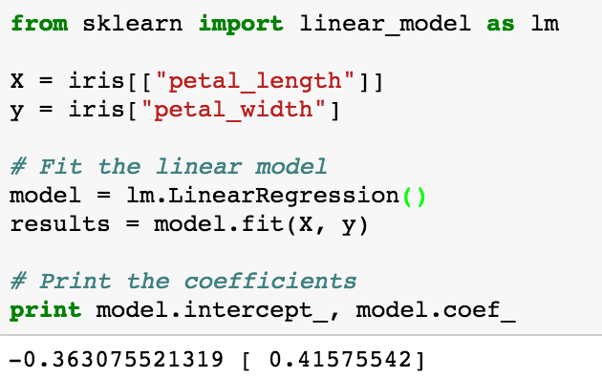
SKLearn
Doesn’t print coefficients
Have to fit on different line
Much easier to graph with
Automatically fits a constant

Slide 3
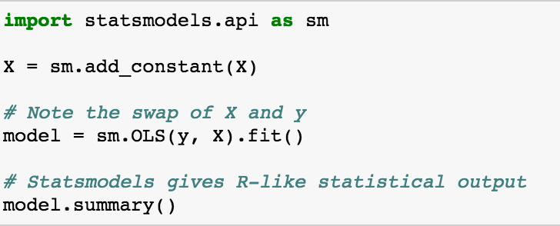
Stats Models Output

Slide 4
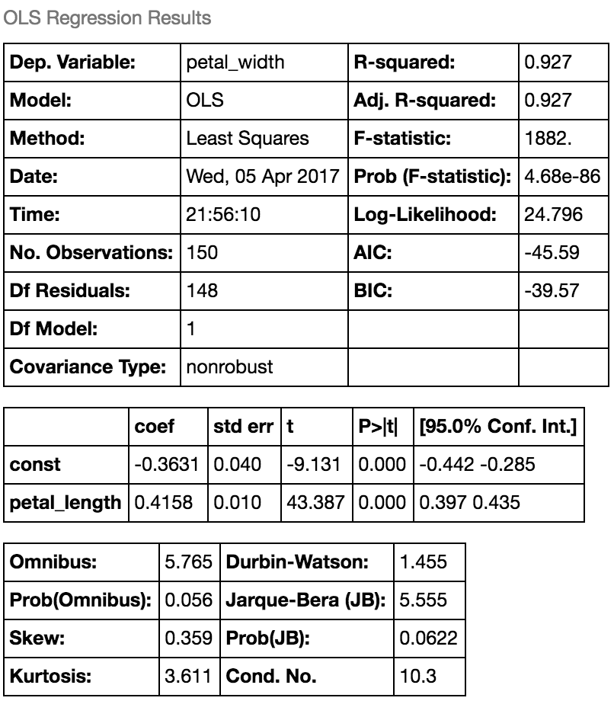
Model Summary
Check your dependent variable
Harder to graph and cross-validate over
Good to check normality of data
Easy to compare variables

Slide 5
Conclusions
If you would like to graph your equation or cross validate, use SKLearn
If you would like more information on your data before you do those things use Stats Models Output

